Slide 1
Lab Evaluation Ⅱ
Snake game
By: group- 4
MEMBERS-
Harshdeep Singh
Himanshu Sharma
Himanshu Singh

Slide 2
High level approach
importing and installing – libraries
snake speed can be adjust by user
real time score calculation while playing
pre-defined keyboard controls

Slide 3
Lower level approach
User case 1 : install libraries; turtle, random,time .
- install libraries using pip cmd
-after that import main code using import function
User case 2 : create GUI and create a real time score calculating
- firstly create a GUI will display number of eggs collected by snake
- by collecting eggs ,snake starting becoming bigger and score increased

Slide 4
Lower level approach
User case 3 :To create a real time calculator which will add up the score in real time as the snake collects the eggs.
-As the Snake will collect eggs the points will add up by 10 and simultaneously.
-Not only will it keep the stats of score but it will also display the maximum score of the no. of times user has played the game.

Slide 5
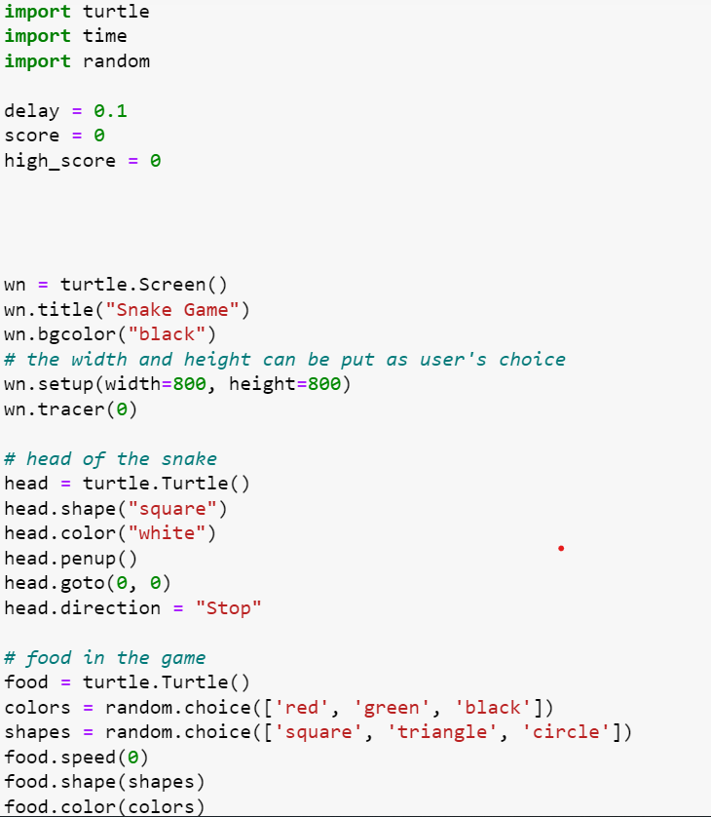
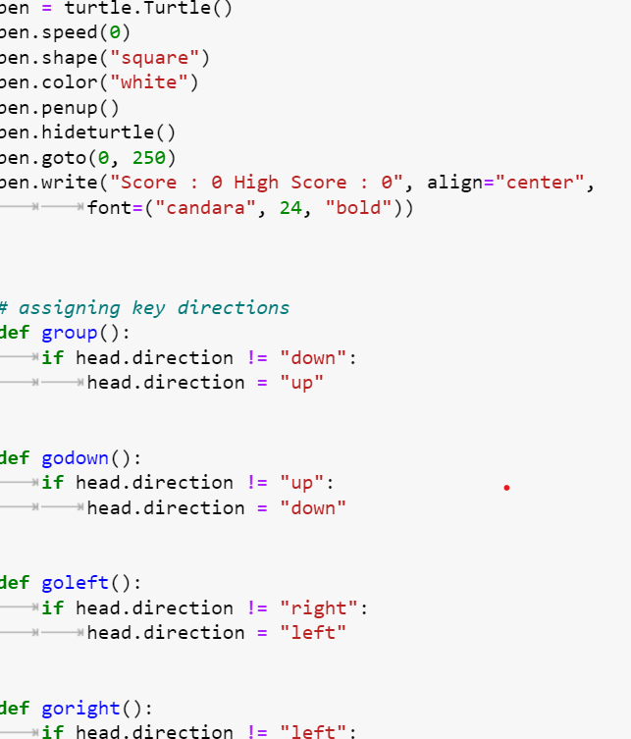
Code Screenshot

Slide 6
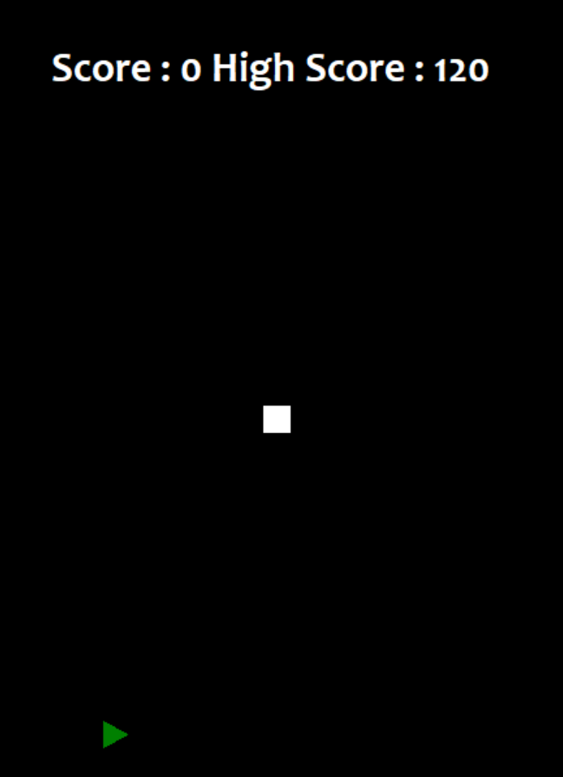
Output Screenshot
Output-Snake game

Slide 7
Advantage of project
It provides recreational pleasure with easy controls
It’s bliss for millennials
It’s simplicity
It takes them down the memory lane of the arcade era of the games when games like these were considered a a marvel.

Slide 8
Future scope of project
* by adding multiple offline mode where more than one keyboard can be connected and used and 2 players can play at once .
* by adding sum 3-D features it can be commercially too

Slide 9
Group info
Harshdeep Singh/2210990383
Himanshu Kohli/2210990404
Himanshu Mehta/2210990406

